Slide 1


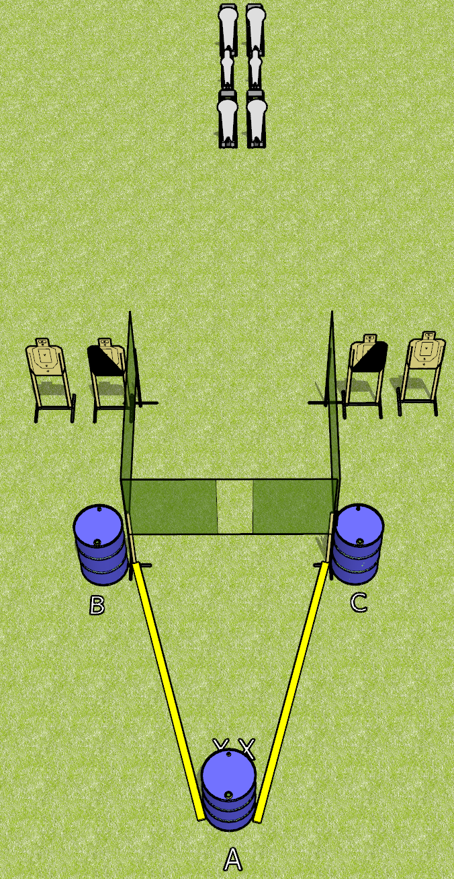
 | Dothan Gun Club – USPSA Match Borrowed from Jake Course Designer : Jake Martens
Round Count 14 rounds 4 USPSA targets 4 colt poppers, 2 mini poppers
Equipment List 4 wall feet 1 left and 1 diagonal hard cover

Slide 2
Borrowed from Jake
Written Stage Briefing
Borrowed from Jake is a 14 round, 70 point, Comstock medium course. There are 4 USPSA targets, 4 colt poppers, and 2 mini poppers. The best 2 hits on paper will score, and steel must fall to score. The start signal is audible.
Start position is toes touching X’s, facing uprange, both hands touching top surface of uprange barrel (A).
Firearm is placed on either down range barrel (B or C), unloaded and unpropped. All magazines to be used on the stage must be placed on any barrel(s) WITHOUT the firearm.
On start signal, engage targets as they become available from within the fault lines.

